Slide 1
CAR price prediction
-Bhavneet Kaur (50122009)
-Simran (50122030)

Slide 2
introduction
The price of a new car in the industry is fixed by the manufacturer with some additional costs incurred by the Government in the form of taxes. So, customers buying a new car can be Assured of the money they invest to be worthy. But, due to the increased prices of new cars and the financial incapability of the customers to buy them, Used Car sales are on the global increase. Therefore, there is an urgent need for a Used Car Price Prediction system which effectively determines the worthiness of the car using a variety of features.
Existing System includes a process where a seller decides a price randomly and buyer has No idea about the car and its value in the present day scenario .In fact ,seller also has no Idea about the car’s existing value or the price he should be selling the car at. To overcome this problem we have developed a model which will be highly effective. Regression algorithms are used because they provide us with continuous value as an output and not a categorized value. Because of which it will be possible to predict the actual price a car rather than the price range of a car. User interface has also been developed which acquires input from any user and displays the Price of a car according to user’s inputs.

Slide 3
Overview of model
LINEAR REGRESSION
Linear regression calculates the estimators of the regression coefficients or simply the predicted weights, denoted with 𝑏₀, 𝑏₁, …, 𝑏ᵣ. They define the estimated regression function 𝑓(𝐱) = 𝑏₀ + 𝑏₁𝑥₁ + ⋯ + 𝑏ᵣ𝑥ᵣ. This function should capture the dependencies between the inputs and output sufficiently well.
Linear regression is probably one of the most important and widely used regression techniques. It’s among the simplest regression methods. One of its main advantages is the ease of interpreting results.

Slide 4
Collection of
raw data
Prediction result
BLOCK DIAGRAM
Improvement
Data cleaning
EDA
Evaluation
Model Building

Slide 5
methodology
Dataset : For this project, we are using the dataset on used car sales from all over the United States, available on Kaggle. The features available in this dataset are Mileage, V.
Pre-processing : In order to get a better understanding of the data, we plotted a histogram of the data. We noticed that the dataset had many outliers, primarily due to large price sensitivity of used cars. Typically, models that are the latest year and have low mileage sell for a premium, however, there were many data points that did not conform to this. This is because accident history and condition can have a significant effect on the car’s price.
Future Work For better performance, we plan to judiciously design deep learning network structures, use adaptive learning rates and train on clusters of data rather than the whole dataset. To correct for overfitting in Random Forest, different selections of features and number of trees will be tested to check for change in performance.

Slide 6
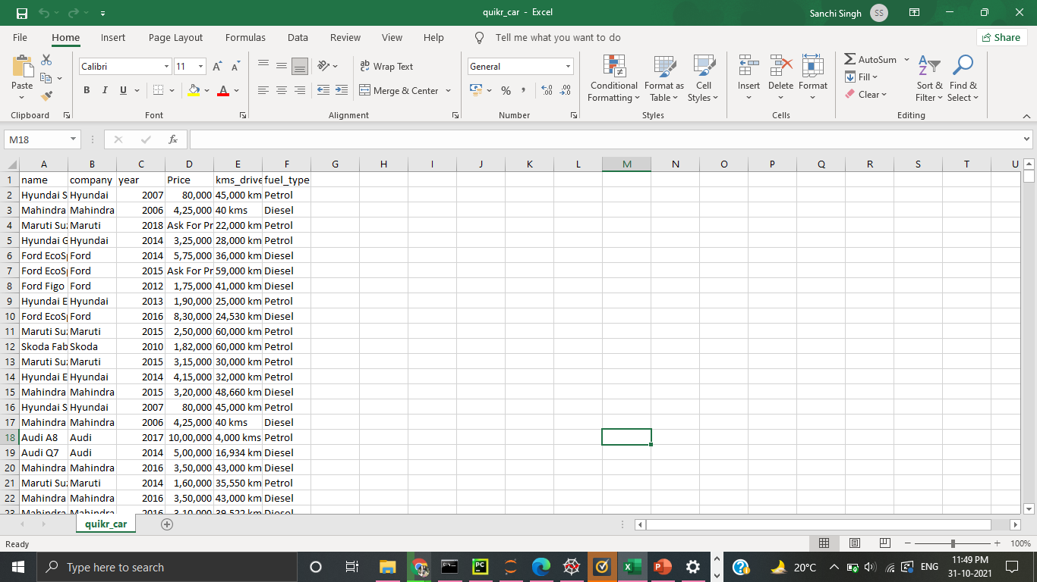
SNAPSHOT OF DATASET

Slide 7
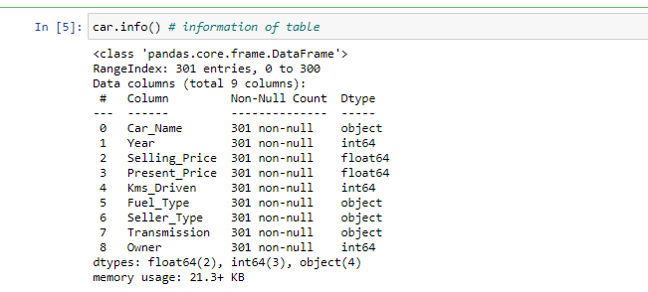
Information of dataset

Slide 8
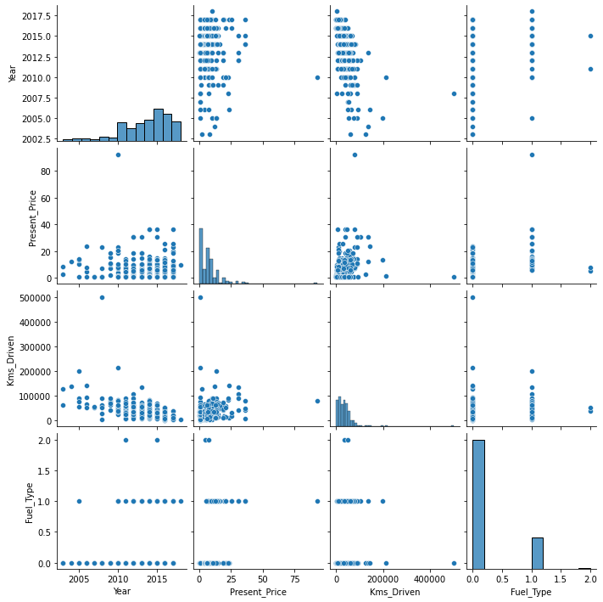
Relationship between columns

Slide 9
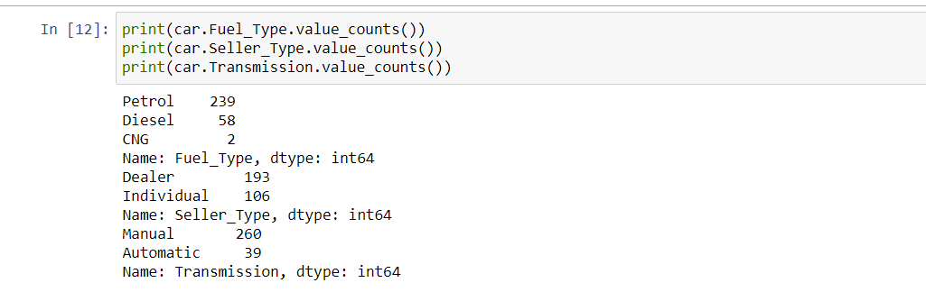
Value_counts of columns

Slide 10
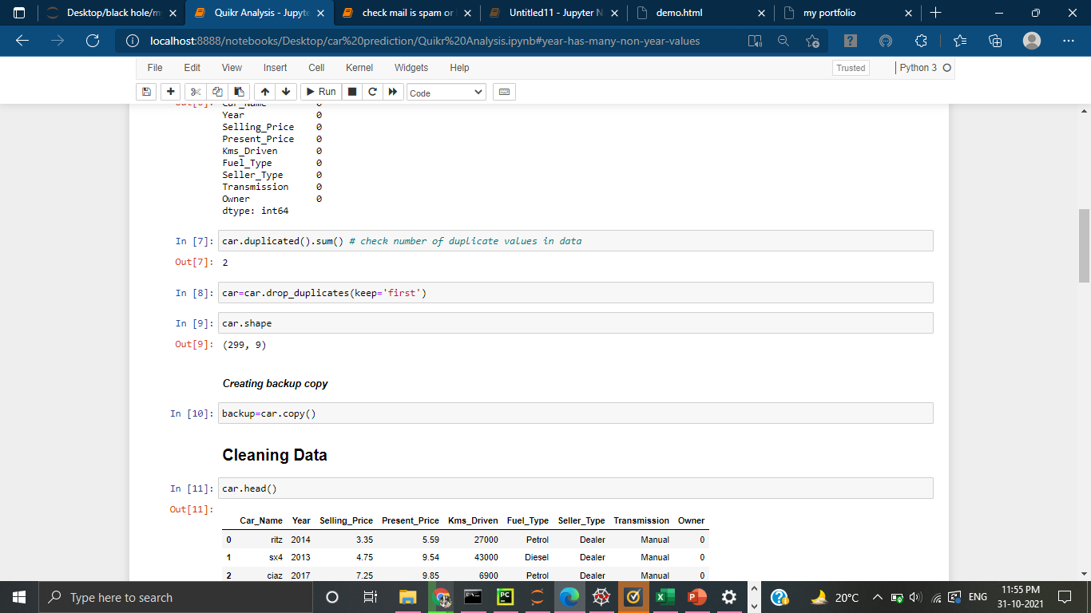
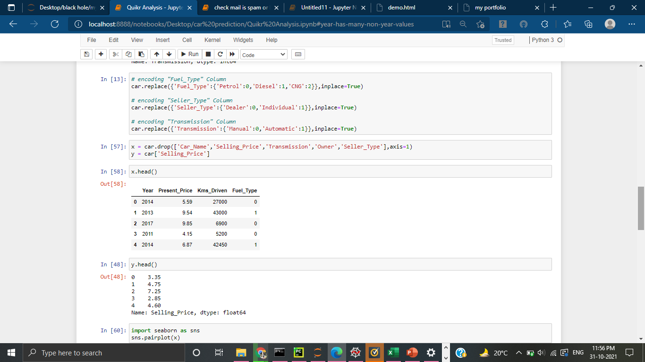
Snapshot of code

Slide 11
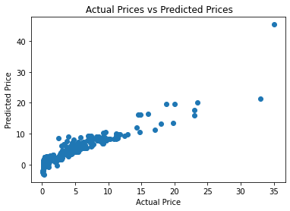
Graph of accuracy of model

Slide 12
References
https://towardsdatascience.com/
https://www.hindawi.com/journals/scn/2020/8873639/
https://searchbusinessanalytics.techtarget.com/definition/linear-regression
http://cs229.stanford.edu/proj2019aut/data/assignment_308832_raw/26612934.pdf
https://www.analyticsvidhya.com/blog/2021/07/car-price-prediction-machine-learning-vs-deep-learning/

Slide 13
THANK YOU

